Slide 1


LITERATURE SURVEY
VISUAL-TO-AUDIO AID FOR VISUALLY IMPAIRED
Siddharth anil naik
Sidharth Pal

Slide 2

INDEX
Search engines
Summary of papers
Key methodologies identified
Modified architecture diagram

Slide 3





SEARCH ENGINES
Sources
https://ieeexplore.ieee.org/Xplore/home.jsp
https://www.dagstuhl.de/typo3temp/pics/efaf8194ef.png
https://library.cit.ie/contentFiles/components/gdNews/11/large/googlescholarlogo1.jpg
https://upload.wikimedia.org/wikipedia/commons/thumb/e/e7/Elsevier.svg/220px-Elsevier.svg.png
https://en.wikipedia.org/wiki/ArXiv

Slide 4
SUMMARY OF SELECTED PAPERS - 1
NAME | Compositional generalization in a deep sequence to sequence model by separating syntax and semantics
AUTHOR | Jake Russi, Jason Jo, Randall O’Reilly, Yoshua Bengio
OBJECTIVE | Proposition of generalization task for capturing compositional structure by separating syntactical and semantic learning
DATA | SCAN
METHODOLOGIES | Bidirectional LSTM implementation using Pytorch, encoding using bidirectional RNN, decoding using RNN and linear function of softmax and Adam optimizer
CONCLUSION | Significant improvement on generalization task by imposing an analogous separation on SCAN dataset as compared to previous works

Slide 5
SUMMARY OF SELECTED PAPERS - 2
NAME | Image Captioning with Semantic Attention
AUTHOR | Quanzeng You, Hailin Jin, Zhaowen Wang, Chen Fang, Jiebo Luo
OBJECTIVE | Proposition of algorithm based on top-down and bottom-up approach for Image captioning with Semantic attention
DATA | MS-COCO, Flickr30k
TOOLS AND ALGORITHMS | BLEU, Meteor, Rouge-L, CIDEr, Linear embedding Model
CONCLUSION | Top-down and bottom-up approach is used which is than coupled with RNN to attend on rich semantic attributes. The proposed method gives state-of-art performance across popular benchmark

Slide 6
SUMMARY OF SELECTED PAPERS - 3
NAME | Short Text Similarity with Word Embeddings
AUTHOR | Tom Kenter, Maarten de Rijke
OBJECTIVE | Advocating a generic method for semantic matching of short texts by building a classifier that predicts semantic similarity score using word embedding of different dimensionality using word alignment method and saliency weighted graph
DATA | Microsoft Research Paraphrase Corpus
METHODOLOGIES | Supervised machine learning approach by implementation of saliency weighted semantic network and an non-weighted semantic network, use of a self-constructed vector from publicly available text corpus - Out of the box, a final Support Vector Classifier with the Radial basis function
CONCLUSION | Computing semantic similarity between short text using semantic only method outperforms previous approaches. The proposed method is independent of NLP tools and hence can be applied to varied domains and languages

Slide 7
SUMMARY OF SELECTED PAPERS - 4
NAME | Analysis of diversity-accuracy trade off in image captioning
AUTHOR | Ruotian Luo, Gregory Shakhnarovich - TTI-Chicago
OBJECTIVE | New metric to measure both diversity and accuracy of image captioning
DATA | MS-Coco
METHODOLOGIES | Naive sampling, biased sampling, beam search
CONCLUSION | Diverse beam search has best trade off but slowest, naive sampling with low temperature is competitive. The existing metrics do nit measure the trade off rather diversity or accuracy distinctly

Slide 8
SUMMARY OF SELECTED PAPERS - 5
NAME | Show, Attend and Tell: Neural Image Caption Generation with Visual Attention
AUTHOR | Kelvin Xu, Jimmy Lei Ba, Ryan Kiros, Kyunghyun Cho, Aaron Courville, Ruslan Salakhutdinov, Richard S. Zemel, Yoshua Bengio
OBJECTIVE | evaluating importance of attention in image captioning tasks
DATA | Flickr 8k/30k, MS-COCO
METHODOLOGIES | CNN, LSTM, Bahdanau attention model
CONCLUSION | Attention model significantly improves caption accuracy. Soft attention (deterministic) is more popular as back propagation is more effective on regular and easier gradient whereas hard attention (schotastic) depends on number if sampling and how well it is sampled

Slide 9
SUMMARY OF SELECTED PAPERS - 6
NAME | LSTM vs. GRU vs. Bidirectional RNN for script generation
AUTHOR | Sanidhya Mangal, Poorva Joshi, Rahul Modak
OBJECTIVE | Comparison of LSTM, GRU and bidirectional recurrent neural networks for text generation
DATA | TV series script
METHODOLOGIES | LSTM, GRU, Bidirectional RNN
CONCLUSION | LSTM are most efficient having the capability to forget irrelevant data, GRU is a bit less accurate however is faster, bidirectional RNN are the most accurate however are the slowest

Slide 10
KEY METHODOLOGIES
IMAGE ENCODERS | AlexNet, InceptionV3, GoogleNet, VGGNet, ResNet
LANGUAGE DECODERS | LSTM, GRU, Language CNN
DATASETS | flickr 8k/30k, MS-COCO, imagenet
EVALUATION METRICS | BLEU, METEOR, CIDEr
KEY PLAYERS | The vOICe SSD, Tactile Vision Sensory Substitution (TVSS), Prosthesis Substituting Vision for Audition (PSVA), The Vibe (open source at sourceforge)

Slide 11
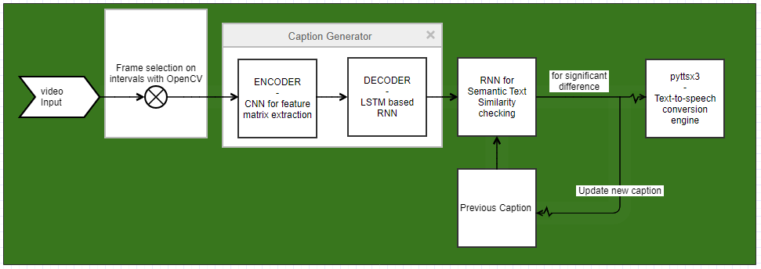
Previously proposed architecture

Slide 12
Modified architecture
Frame selection +
preprocessing with
InceptionV3
GRU Based
Bahdanau Attention

Slide 13
Bibliography
https://arxiv.org/abs/1904.09708
https://ieeexplore.ieee.org/document/7780872
https://dl.acm.org/doi/10.1145/2806416.2806475
https://arxiv.org/abs/2002.11848
https://dl.acm.org/doi/10.5555/3045118.3045336
https://arxiv.org/abs/1908.04332

Slide 14

Image Source - https://kinetic-bands.eu/articles/questions_and_answers/

Slide 15
Thank You

